Slide 1

Psychopharmacology: Drugs, the Brain, and Behavior
by Meyer, Farrar, Biezonski, Yates

Slide 2
Chapter 6
Serotonin
6.1 Serotonin Synthesis, Release, and Inactivation
6.2 Basic Features of the Serotonergic System: Anatomical Organization, Cell Firing, and Receptor Families
6.3 Behavioral and Physiological Functions of Serotonin

Slide 3
Chapter 6
Learning Objectives (1 of 3)
6.1.1 (a) List the biochemical steps involved in the synthesis of 5-HT, (b) name the major metabolite of 5-HT, and (c) explain the mechanisms whereby changes in tryptophan availability, either through diet or by other manipulations, alter 5-HT synthesis.
6.1.2 Discuss the effects on cognition, mood, and sleep of either elevating or depleting tryptophan levels in humans.
6.1.3 Describe the main features of a serotonergic neuron, including (a) the enzymes required for 5-HT synthesis and metabolism, (b) the proteins that transport 5-HT either from the cytoplasm into synaptic vesicles or from the extracellular fluid into the serotonergic neuron (i.e., reuptake), and (c) the autoreceptors that regulate serotonergic cell firing and 5-HT release at the nerve terminals.
6.1.4 Discuss the current state of knowledge regarding ecstasy/MDMA, including (a) its primary mechanism of action, (b) its subjective and behavioral effects at typical recreational doses, (c) the toxic effects of MDMA overdose, (d) evidence for serotonergic neurotoxicity in both humans and experimental animals after high doses and/or chronic use, and (e) recent clinical use of MDMA-assisted psychotherapy for chronic PTSD.

Slide 4
Chapter 6
Learning Objectives (2 of 3)
6.2.1 Name the two brainstem nuclei that give rise to forebrain serotonergic projections.
6.2.2 (a) Describe how serotonergic cell firing varies according to behavioral state, and (b) discuss the evidence for a role for serotonergic neuronal activity in the control of sleep and waking/arousal.
6.2.3 (a) List all of the serotonergic receptor subtypes, (b) describe the signaling mechanisms of 5-HT1A and 5-HT2A receptors, and (c) list several agonists and antagonists at these receptor subtypes.
6.2.4 Discuss the therapeutic applications of drugs that act on the 5-HT1B/1D, 5-HT1F, and 5-HT3 subtypes and the mechanisms responsible for the therapeutic benefit in each case.

Slide 5
Chapter 6
Learning Objectives (3 of 3)
6.3.1 (a) Identify the various methodological approaches used to study serotonergic functioning in humans and in laboratory animals, and (b) describe the behavioral and physiological consequences of genetically manipulating animals so that they lack brain 5-HT throughout life.
6.3.2 Describe the role of 5-HT in anxiety, with an emphasis on the 5-HT1A receptor subtype.
6.3.3 Describe (a) the differences between reactive and proactive aggression in humans, (b) the neural circuitry that mediates reactive aggression, and (c) the serotonin deficiency hypothesis of aggression.
6.3.4 Explain how 5-HT is involved in the control of hunger and eating behavior, including both central (i.e., hypothalamic) and peripheral (i.e., gut) mechanisms.

Slide 6
Serotonin Synthesis, Release, and Inactivation (1 of 12)
Serotonin synthesis is regulated by enzymatic activity and precursor availability
Serotonin (5-hydroxytryptamine, or 5-HT) neurotransmitter used by serotonergic neurons
Synthesized from tryptophan in two steps:
  Catalyzed by tryptophan hydroxylase (TPH), product: 5-hydroxy-tryptophan (5-HTP) (rate-limiting step)
  Catalyzed by aromatic amino acid decarboxylase (AADC) to form 5-HT
Notes:
Instructor Notes:

Slide 7
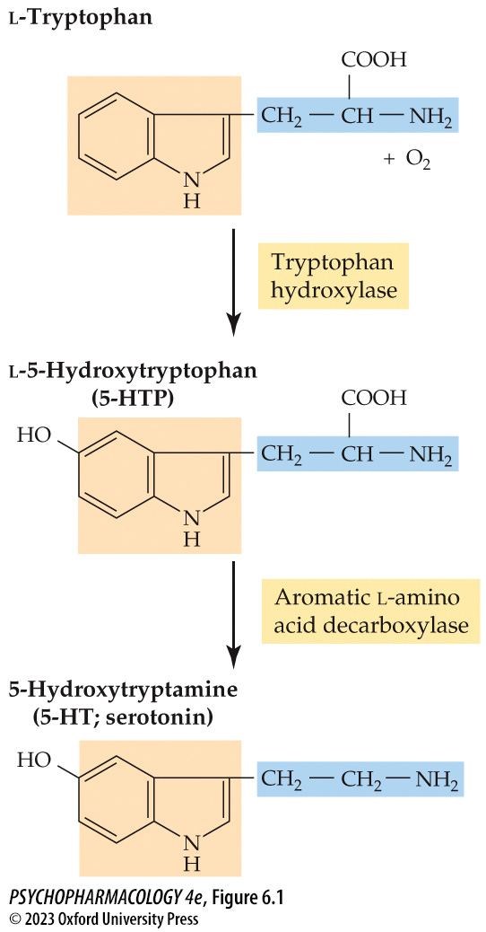
FIGURE 6.1 Synthesis of serotonin
Notes:
FIGURE 6.1 Synthesis of serotonin
Serotonin (5-HT) is synthesized from the amino acid tryptophan in two steps, catalyzed by the enzymes tryptophan hydroxylase and aromatic amino acid decarboxylase.

Slide 8
Serotonin Synthesis, Release, and Inactivation (2 of 12)
Serotonin synthesis is regulated by enzymatic activity and precursor availability
Two forms of TPH:
  TPH2: only in serotonergic neurons
  TPH1: in nonnerounal cells in the gut and pineal gland
Neuroendocrine tumors in the gut secrete 5-HT; elevated blood levels cause carcinoid syndrome
Can be treated with telotristat, a nonselective TPH inhibitor; does not cross blood–brain barrier, only blocks peripherally expressed TPH1.
Notes:
Instructor Notes:
TPH1: enterochromaffin cells located in the gut and melatonin-secreting cells in the pineal gland.

Slide 9
Serotonin Synthesis, Release, and Inactivation (3 of 12)
Serotonin synthesis is regulated by enzymatic activity and precursor availability
Serotonin synthesis can be stimulated by tryptophan or 5-HTP.
Tryptophan from diet: ratio of tryptophan to other amino acid competitors for transport across blood–brain barrier determines whether serotonin synthesis is stimulated or not.
Insulin stimulates uptake of amino acids, except tryptophan. A low-protein, high-carbohydrate meal will increase ratio of tryptophan to competing large neutral amino acids (LNAA)
Notes:
Instructor Notes:

Slide 10
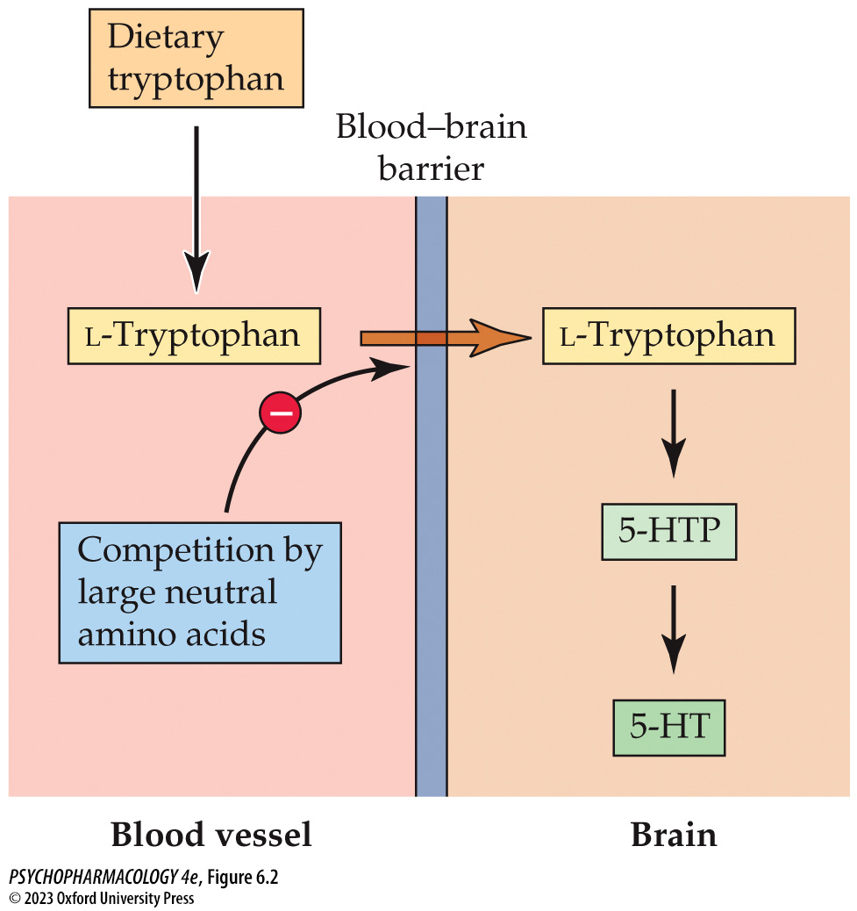
FIGURE 6.2 Tryptophan entry into the brain and 5-HT synthesis
Notes:
FIGURE 6.2 Tryptophan entry into the brain and 5-HT synthesis
Transport and synthesis are regulated by the relative availability of tryptophan versus large neutral amino acids that compete with it for transport across the blood–brain barrier. In rats, a high-protein, low-carbohydrate meal does not increase brain tryptophan levels or 5-HT synthesis rate, because of this competitive process. However, the ratio of circulating tryptophan to large neutral amino acids is ele­vated after a high-carbohydrate, low-protein meal, thereby enhancing entry of tryptophan into the brain and stimulating 5-HT synthesis.

Slide 11
Serotonin Synthesis, Release, and Inactivation (4 of 12)
Serotonin synthesis is regulated by enzymatic activity and precursor availability
Depleting 5-HT to assess its role in behavior:
Para-chlorophenylalanine (PCPA) selectively blocks 5-HT synthesis by irreversibly inhibiting TPH
Acute tryptophan depletion (ATD) large doses of amino acids minus tryptophan
Notes:
Instructor Notes:

Slide 12
Serotonin Synthesis, Release, and Inactivation (5 of 12)
Serotonin synthesis is regulated by enzymatic activity and precursor availability
Elevating tryptophan availability has been shown to enhance cognitive functions such as memory or attention, elevate mood, and improve sleep
Tryptophan loading: administration of pure tryptophan
Dietary:
  Supplemented with α-lactalbumin or other high-tryptophan proteins
  Consumption of a diet rich in carbohydrates but low in protein.
Notes:
Instructor Notes:

Slide 13
Serotonin Synthesis, Release, and Inactivation (6 of 12)
Serotonin synthesis is regulated by enzymatic activity and precursor availability
Reducing brain 5-HT using the ATD method seems to impair memory consolidation of verbal information but has little or no influence on working memory or attention.
ATD also induced a negative cognitive bias, and reduced sleep duration and quality.
Notes:
Instructor Notes:
Negative cognitive bias: individuals display increased sensitivity to threat- or punishment-related stimuli. Effect may be mediated by reducing serotonergic activity in an anxiety/fear-related circuit that includes the amygdala and medial frontal cortex.

Slide 14
Serotonin Synthesis, Release, and Inactivation (7 of 12)
Serotonin synthesis is regulated by enzymatic activity and precursor availability
95% of ingested tryptophan is metabolized to kynurenine rather than 5-HT.
Kynurenine is further metabolized in the kynurenine pathway; stress and inflammation can stimulate enzymes involved.
Kynurenine metabolites have been implicated in several psychiatric disorders and neurodegenerative diseases.
Notes:
Instructor Notes:

Slide 15
Serotonin Synthesis, Release, and Inactivation (8 of 12)
Similar processes regulate storage, release, and inactivation of serotonin and the catecholamines
5-HT is transported into synaptic vesicles by vesicular monoamine transporter 2 (VMAT2).
Reserpine (VMAT blocker) depletes 5-HT, which is broken down when not protected in vesicles.
Terminal autoreceptors directly inhibit 5-HT release, somato-dendritic autoreceptors inhibit release by slowing the rate of nerve firing.
Notes:
Instructor Notes:

Slide 16
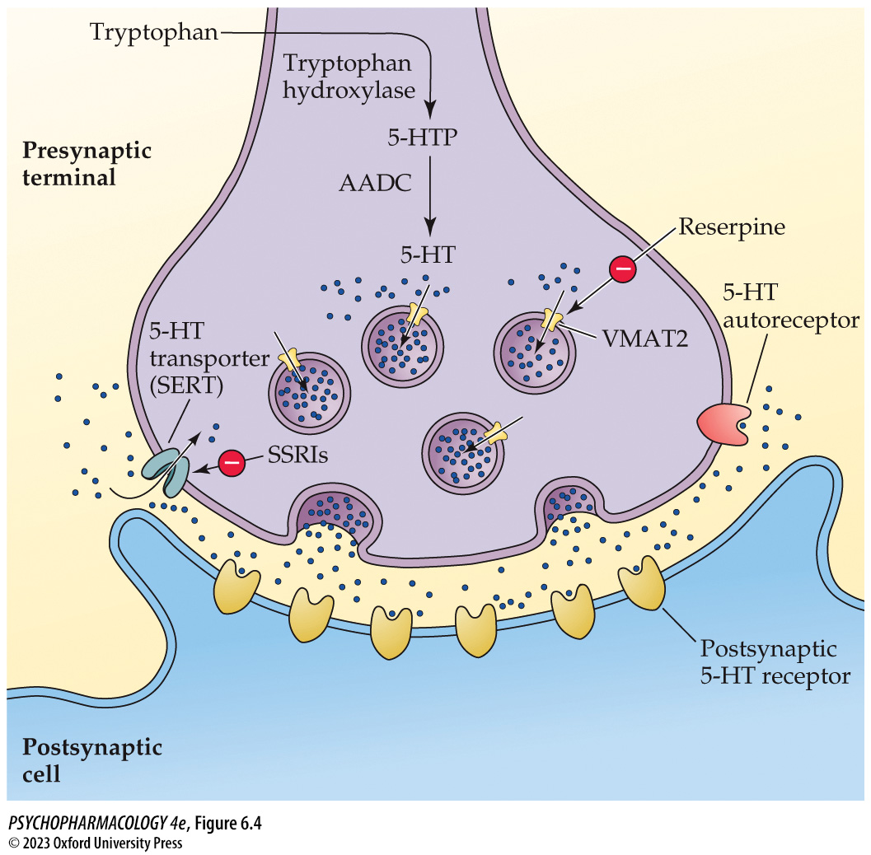
FIGURE 6.4 Features of a serotonergic neuron
Notes:
FIGURE 6.4 Features of a serotonergic neuron
Serotonergic neurons express the enzymes tryptophan hydroxylase and aromatic l-amino acid decarboxylase (AADC), the vesicular monoamine transporter VMAT2, the 5-HT transporter (SERT), and 5-HT_{1B} or 5-HT_{1D} autoreceptors in their terminals. 5-HTP, 5-hydroxytryptophan; SSRIs, selective serotonin reuptake inhibitors.

Slide 17
Serotonin Synthesis, Release, and Inactivation (9 of 12)
Similar processes regulate storage, release, and inactivation of serotonin and the catecholamines
Release of 5-HT can be stimulated by drugs that are based on the structure of amphetamine: para-chloroamphetamine, fenfluramine, and MDMA (street name ecstasy)
In the 1970s, MDMA was proposed as a potential adjunct to psychotherapy, but it quickly became a recreational drug.
Notes:
Instructor Notes:

Slide 18
Serotonin Synthesis, Release, and Inactivation (10 of 12)
BOX 6.1 OF SPECIAL INTEREST
“Ecstasy”—Harmless Feel-Good Drug, Dangerous Neurotoxin, or Miracle Medication?
MDMA effects: heightened arousal, euphoria, enhanced perceptual awareness, and prosocial effects (an entactogen)
Potential toxic effects: serotonin syndrome; can be life-threatening
High MDMA doses result in 5-HT depletion in experimental animals; heavy ecstasy use causes serotonergic deficits – determined by neuroimaging
Low controlled doses of MDMA have recently been shown to be beneficial as an adjunct to psychotherapy in chronic PTSD.
Notes:
Instructor Notes:
Entactogens: compounds that promote empathy and closeness to others in the absence of hallucinogenic effects

Slide 19
Serotonin Synthesis, Release, and Inactivation (11 of 12)
Similar processes regulate storage, release, and inactivation of serotonin and the catecholamines
Inactivation of 5-HT: reuptake by 5-HT transporter (SERT)
Antidepressant drugs such as fluoxetine (Prozac) are selective serotonin reuptake inhibitors (SSRIs)
SERT knockout mice show a variety of behavioral and physiological abnormalities
5-HT breakdown is catalyzed by MAO-A to the metabolite 5-hydroxyindoleacetic acid (5-HIAA)
Notes:
Instructor Notes:

Slide 20
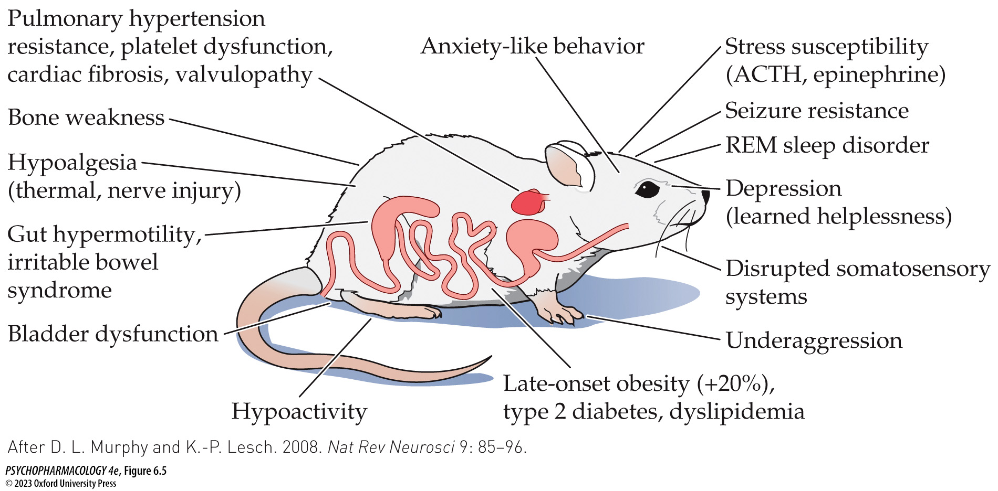
FIGURE 6.5 Behavioral and physiological phenotypes of SERT knockout mice
Notes:
FIGURE 6.5 Behavioral and physiological phenotypes of SERT knockout mice Widespread SERT expression both in the brain (by serotonergic neurons and their axons and terminals) and in various peripheral tissues leads to dysfunction in many behavioral and physiological systems when normal 5-HT uptake is impaired by loss of this transporter. ACTH, adrenocorticotropic hormone; REM, rapid-eye-movement. (After D. L. Murphy and K.-P. Lesch. 2008. Nat Rev Neurosci 9: 85–96.)

Slide 21
Serotonin Synthesis, Release, and Inactivation (12 of 12)
CLICKER QUESTION 1
How does Prozac work?
By inhibiting MAO-A
By blocking synthesis of TPH
By blocking the 5-HT transporter
Notes:
Instructor Notes:
Correct answer: c

Slide 22
Review of Learning Objectives (1 of 3)
6.1.1 (a) List the biochemical steps involved in the synthesis of 5-HT, (b) name the major metabolite of 5-HT, and (c) explain the mechanisms whereby changes in tryptophan availability, either through diet or by other manipulations, alter 5-HT synthesis.
6.1.2 Discuss the effects on cognition, mood, and sleep of either elevating or depleting tryptophan levels in humans.
6.1.3 Describe the main features of a serotonergic neuron, including (a) the enzymes required for 5-HT synthesis and metabolism, (b) the proteins that transport 5-HT either from the cytoplasm into synaptic vesicles or from the extracellular fluid into the serotonergic neuron (i.e., reuptake), and (c) the autoreceptors that regulate serotonergic cell firing and 5-HT release at the nerve terminals.
6.1.4 Discuss the current state of knowledge regarding ecstasy/MDMA, including (a) its primary mechanism of action, (b) its subjective and behavioral effects at typical recreational doses, (c) the toxic effects of MDMA overdose, (d) evidence for serotonergic neurotoxicity in both humans and experimental animals after high doses and/or chronic use, and (e) recent clinical use of MDMA-assisted psychotherapy for chronic PTSD.

Slide 23
Basic Features of the Serotonergic System:
Anatomical Organization, Cell Firing, and Receptor Families (1 of 7)
The serotonergic system originates in the brainstem and projects to all forebrain areas
Serotonergic neurons in the CNS are found along the midline of the brainstem (medulla, pons, and midbrain), loosely associated with the raphe nuclei.
Dorsal raphe nucleus (DRN) and median raphe nucleus (MRN) give rise to most of the serotonergic fibers in the forebrain.
In the cortex, nerve fibers are dense at the surface, which has a high density of dendrites and synaptic connections.
Notes:
Instructor Notes:

Slide 24
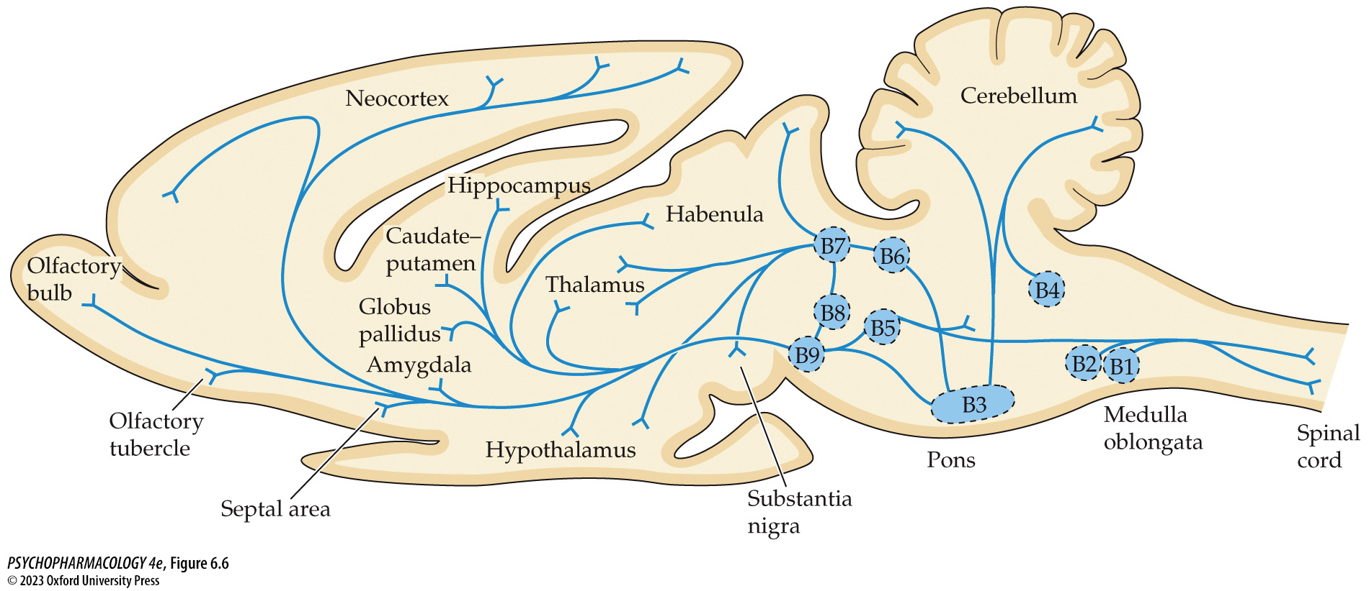
FIGURE 6.6 Anatomy of the serotonergic system
Notes:
FIGURE 6.6 Anatomy of the serotonergic system
The B7 cell group corresponds to the dorsal raphe, and the B8 cell group corresponds to the median raphe.

Slide 25
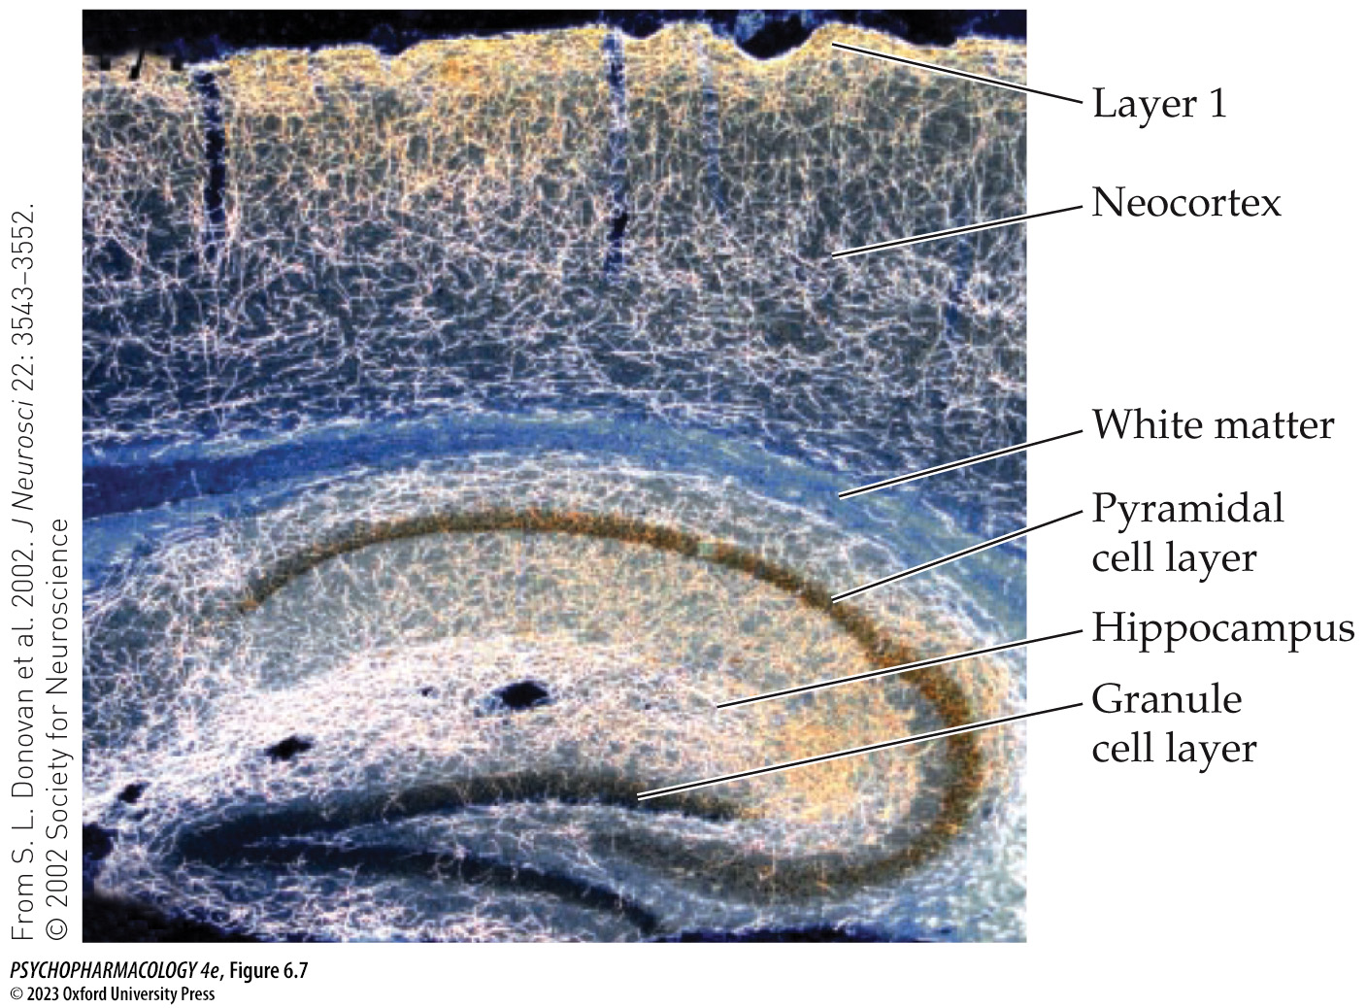
FIGURE 6.7 Photomicrograph of serotonergic fibers in the mouse neocortex and hippocampus
Notes:
FIGURE 6.7 Photomicrograph of serotonergic fibers in the mouse neocortex and hippocampus
The photomicrograph shows a parasagittal section from a young mouse brain that was stained using an antibody against the 5-HT transporter. This method permits visualization of serotonergic fibers (axons) because the transporter protein is present throughout the length of the axonal membrane. The photomicrograph was taken using dark-field micro­scopy, which reverses light and dark structures. Consequently, the stained axons appear brightly colored, whereas the cell bodies of the hippocampal pyramidal cell layer and dentate gyrus granule cell layer appear dark. Note that in some areas, such as the deep layers of the hippocampus and layer 1 of the cortex, the serotonergic axons are so numerous that individual fibers cannot be resolved at the present magnification.

Slide 26
Basic Features of the Serotonergic System:
Anatomical Organization, Cell Firing, and Receptor Families (2 of 7)
The firing of dorsal raphe serotonergic neurons varies with behavioral states
First demonstrated in cats: when awake, each nerve cell fires at a regular rate (tonic firing); become irregular with slow-wave sleep, and stop firing during REM sleep.
Research with DRN and MRN knockout mice: slow, tonic firing of DRN neurons promotes sleep (non-REM sleep); burst firing of the same cells favors a state of wakefulness
Notes:
Instructor Notes:

Slide 27
Basic Features of the Serotonergic System:
Anatomical Organization, Cell Firing, and Receptor Families (3 of 7)
There is a large family of serotonin receptors, most of which are metabotropic
14 receptor subtypes; 5-HT_{1A} and 5-HT_{2A} are most well known
5-HT_{1A} receptors: concentrated in the hippocampus, septal area, amygdala, and DRN; inhibit adenylyl cyclase to decrease cAMP synthesis; increase opening of K⁺ channels and membrane hyperpolarization
5-HT_{1A} receptor agonists include buspirone, ipsapirone, and 8-hydroxy-2-(di-n-propylamino) tetralin (8-OHDPAT).
WAY 100635 is a 5-HT_{1A} receptor antagonist.
Notes:
Instructor Notes:

Slide 28
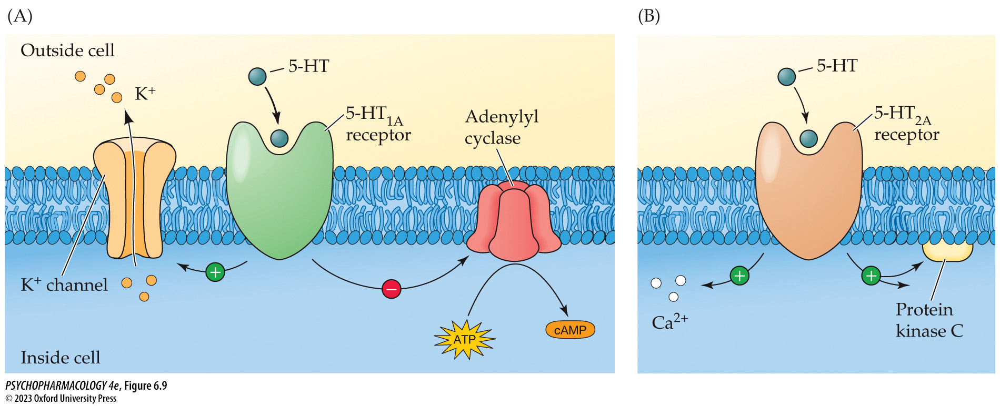
FIGURE 6.9 5-HT_{1A} and 5-HT_{2A} receptors operate through different signaling mechanisms
Notes:
FIGURE 6.9 5-HT_{1A} and 5-HT_{2A} receptors operate through different signaling mechanisms
5-HT_{1A} receptors inhibit cAMP production and activate K⁺ channel opening (A), whereas 5-HT_{2A} receptors increase intracellular Ca²⁺ levels and stimulate protein kinase C via the phosphoinositide second-­messenger system (B). For purposes of simplification, the G proteins required for coupling the receptors to their signaling pathways are not shown.

Slide 29
Basic Features of the Serotonergic System:
Anatomical Organization, Cell Firing, and Receptor Families (4 of 7)
There is a large family of serotonin receptors, most of which are metabotropic
5-HT_{2A} receptors occur in the cortex and other brain areas
Function via the phosphoinositide second-messenger system: increases Ca²⁺ levels in the postsynaptic cell; also activates protein kinase C (PKC)
5-HT_{2A} agonist: 1-(2,5-dimethoxy-4-iodophenyl)-2-aminopropane (DOI).
5-HT_{2A} antagonists: ketanserin and ritanser.
Notes:
Instructor Notes:

Slide 30
Basic Features of the Serotonergic System:
Anatomical Organization, Cell Firing, and Receptor Families (5 of 7)
There is a large family of serotonin receptors, most of which are metabotropic
DOI and related drugs are hallucinogenic in humans.
Hallucinogenic effects of lysergic acid diethylamide (LSD) may stem from its ability to stimulate 5-HT_{2A} receptors.
Several drugs used to treat schizophrenia with reduced motor side effects act as inverse agonists at 5-HT_{2A} and/or 5-HT_{2C} receptors
Notes:
Instructor Notes:
Inverse agonists don’t merely block a receptor, they exert the opposite effect that an agonist would produce.

Slide 31
Basic Features of the Serotonergic System:
Anatomical Organization, Cell Firing, and Receptor Families (6 of 7)
There is a large family of serotonin receptors, most of which are metabotropic
Some medications target other receptor subtypes
Migraine headaches: 5-HT_{1B/1D} agonists (triptans) stimulate cerebral vasoconstriction; 5-HT_{1F} agonist Lasmiditan (Reyvow) reduces activity in the pain pathway
5-HT₃ antagonists such as ondansetron (Zofran), granisetron (Kytril), and palonosetron (Aloxi) can counteract nausea and vomiting associated with chemotherapy and radiation treatments
Notes:
Instructor Notes:
Triptans: sumatriptan [Imitrex or Zecuity], zolmitriptan [Zomig], frovatriptan [Frova], naratriptan [Amerge]

Slide 32
Basic Features of the Serotonergic System:
Anatomical Organization, Cell Firing, and Receptor Families (7 of 7)
CLICKER QUESTION 2
Most serotonergic neurons in the CNS are located in the
cerebral cortex.
raphe nuclei.
amygdala.
hippocampus.
Notes:
Instructor Notes:
Correct answer: b

Slide 33
Review of Learning Objectives (2 of 3)
6.2.1 Name the two brainstem nuclei that give rise to forebrain serotonergic projections.
6.2.2 (a) Describe how serotonergic cell firing varies according to behavioral state, and (b) discuss the evidence for a role for serotonergic neuronal activity in the control of sleep and waking/arousal.
6.2.3 (a) List all of the serotonergic receptor subtypes, (b) describe the signaling mechanisms of 5-HT1A and 5-HT2A receptors, and (c) list several agonists and antagonists at these receptor subtypes.
6.2.4 Discuss the therapeutic applications of drugs that act on the 5-HT1B/1D, 5-HT1F, and 5-HT3 subtypes and the mechanisms responsible for the therapeutic benefit in each case.

Slide 34
Behavioral and Physiological Functions of Serotonin (1 of 12)
Multiple approaches have identified several behavioral and physiological functions of serotonin
Methodological approaches in human clinical research:
  Compare levels of 5-HIAA in CSF or 5-HT and 5-HIAA in postmortem brain regions with behavioral traits or neuropsychiatric disorders.
  Assess responses to SSRIs or receptor agonists and antagonists.
  Identify associations between psychiatric disorders and polymorphisms in the genes for SERT or for serotonergic receptors.
Notes:
Instructor Notes:

Slide 35
Behavioral and Physiological Functions of Serotonin (2 of 12)
Multiple approaches have identified several behavioral and physiological functions of serotonin
Pharmacological tools:
Serotonergic neurotoxins include para-chloroamphetamine, MDMA, 5,6-dihydroxytryptamine (5,6-DHT) and (5,7-DHT)
Lesioning results in changes in hunger and eating behavior, anxiety, pain sensitivity, and learning and memory
Notes:
Instructor Notes:

Slide 36
Behavioral and Physiological Functions of Serotonin (3 of 12)
Multiple approaches have identified several behavioral and physiological functions of serotonin
TPH2 knockout mice have complete loss of 5-HT in the brain; can be temporarily restored with 5-HTP
Most consistently observed behavioral effect of eliminating 5-HT: large increase in aggressive behavior measured by the resident-intruder test
Reversed by 5-HTP plus carbidopa (AADC inhibitor)
Notes:
Instructor Notes:
Carbidopa: AADC inhibitor that doesn’t cross the blood–brain barrier – blocks AADC conversion of 5-HTP to 5-HT in peripheral tissues 5-HTP to 5-HT. This method permits more 5-HTP to be available to the brain.

Slide 37
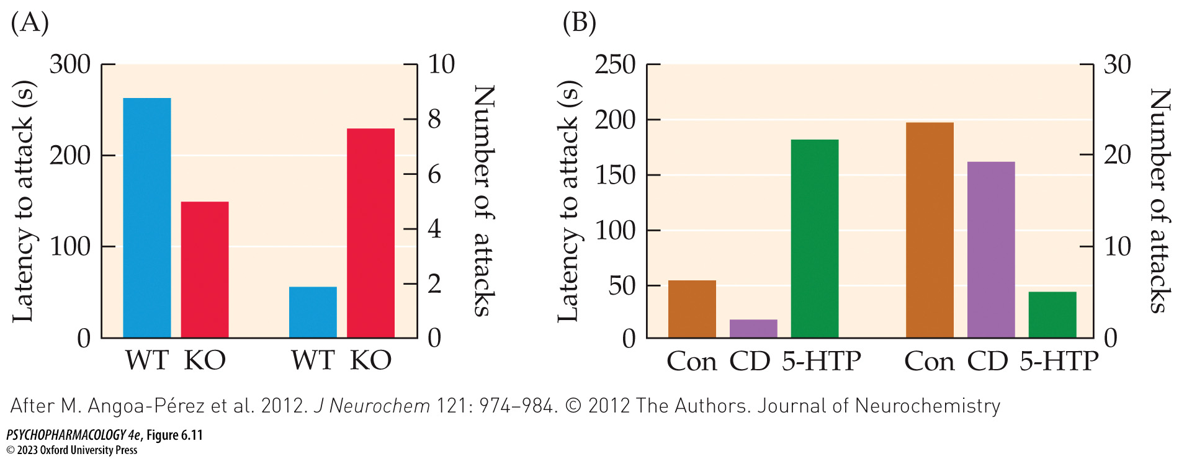
FIGURE 6.11 Impulsive aggression in male TPH2-knockout mice
Notes:
FIGURE 6.11 Impulsive aggression in male TPH2-knockout mice
Adult male TPH2-knockout (KO) and wild-type (WT) mice were tested for impulsive aggression using the resident–­intruder paradigm. (A) Compared with WT controls, the resident KO mice showed a reduced latency to attack (left bars) and an increased number of attacks (right bars) directed toward the intruder. (B) In KO mice, administration of 5-HTP plus carbidopa (5-HTP group) but not carbidopa alone (CD group) increased the latency to attack and reduced the number of attacks, compared with the control group given drug vehicle alone (Con). (After M. Angoa-Pérez et al. 2012. J Neurochem 121: 974–984. © 2012 The Authors. Journal of Neurochemistry © 2012 International Society for Neurochemistry.)

Slide 38
Behavioral and Physiological Functions of Serotonin (4 of 12)
Multiple approaches have identified several behavioral and physiological functions of serotonin
Other behaviors of TPH2-knockout mice:
  More impulsive and compulsive
  Less anxious
  Have poor social communication and social behaviors, including maternal deficit
Physiological deficits:
  Poor thermoregulation
  Abnormal respiration, including apnea
Notes:
Instructor Notes:
Hypothesis: abnormalities in the serotonergic system may play a critical role in some cases of sudden infant death syndrome (SIDS)

Slide 39
Behavioral and Physiological Functions of Serotonin (5 of 12)
Multiple approaches have identified several behavioral and physiological functions of serotonin
5-HT has a key role in regulation of anxiety
SSRIs are used to treat anxiety disorders; target 5-HT_{1A} receptors: buspirone (BuSpar), Vilazodone (Viibryd)
In experimental animals, partial and full 5-HT_{1A} receptor agonists have anxiolytic effects; 5-HT_{1A}-knockout mice show increased anxiety-like behavior
Notes:
Instructor Notes:

Slide 40
Behavioral and Physiological Functions of Serotonin (6 of 12)
Multiple approaches have identified several behavioral and physiological functions of serotonin
Are anxiety-regulating 5-HT_{1A} receptors postsynaptic or presynaptic?
Experiments show that excitation of the serotonergic nerve terminals (increases 5-HT release) had an anxiolytic effect – increased time in open-arm of elevated plus-maze; inhibition of the terminals was anxiogenic.
Results indicate the importance of postsynaptic 5-HT_{1A} receptors in reducing anxiety.
Notes:
Instructor Notes:

Slide 41
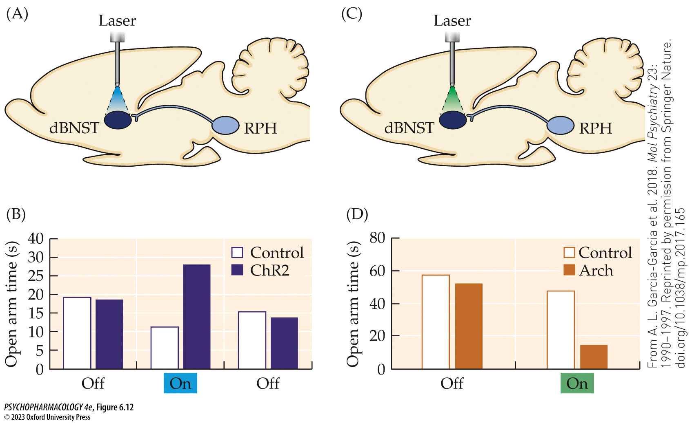
FIGURE 6.12 Effects of optogenetic excitation or inhibition of serotonergic nerve terminals in the dorsal bed nucleus of the stria terminalis (dBNST) on anxiety-like behavior in the elevated plus-maze
Notes:
FIGURE 6.12 Effects of optogenetic excitation or inhibition of serotonergic nerve terminals in the dorsal bed nucleus of the stria terminalis (dBNST) on anxiety-like behavior in the elevated plus-maze
Mice were genetically manipulated to express either the excitatory blue-light sensitive protein channelrhodopsin-2 (ChR2) or the inhibitory green-light sensitive protein archaerhodopsin (Arch) in raphe (RPH) serotonergic neurons. The animals were then implanted with fiber-optic probes in the dBNST to permit delivery of blue or green light to this area by a laser. Control mice received all the same procedures except for ChR2 or Arch gene expression. Delivery of blue light to excite the serotonergic nerve terminals was anxiolytic in the ChR2 mice but not the controls as shown by increased time spent in the open arms of the maze (A and B). This increase only occurred when the light was ON. In contrast, delivery of green light to inhibit the serotonergic nerve terminals was anxiogenic in the Arch mice but not the controls as shown by reduced time spent in the open arms (C and D). Note the difference in open-arm time under control conditions between the two experiments. To allow the genetic manipulations to have clear effects, the researchers altered the baseline experimental parameters to be more anxiety-provoking (i.e., less open-arm time in the controls) when they expected to produce an anxiolytic effect of the laser light but less anxiety-provoking (i.e., more open-arm time in the controls) when they expected to produce an anxiogenic effect of the laser light. (From A. L. Garcia-Garcia et al. 2018. Mol Psychiatry 23: 1990–1997. Reprinted by permission from Springer Nature. doi.org/10.1038/mp.2017.165)

Slide 42
Behavioral and Physiological Functions of Serotonin (7 of 12)
Multiple approaches have identified several behavioral and physiological functions of serotonin
Reactive aggression: response to provocation, threat, or frustration; accompanied by anger or rage; proactive aggression: planned; to achieve a benefit
Neural circuit underlying reactive aggression in humans includes cortical areas, striatum, amygdala, BNST, hippocampus, hypothalamus, and periaqueductal gray
Amygdala and BNST: process threatening stimuli
Notes:
Instructor Notes:

Slide 43
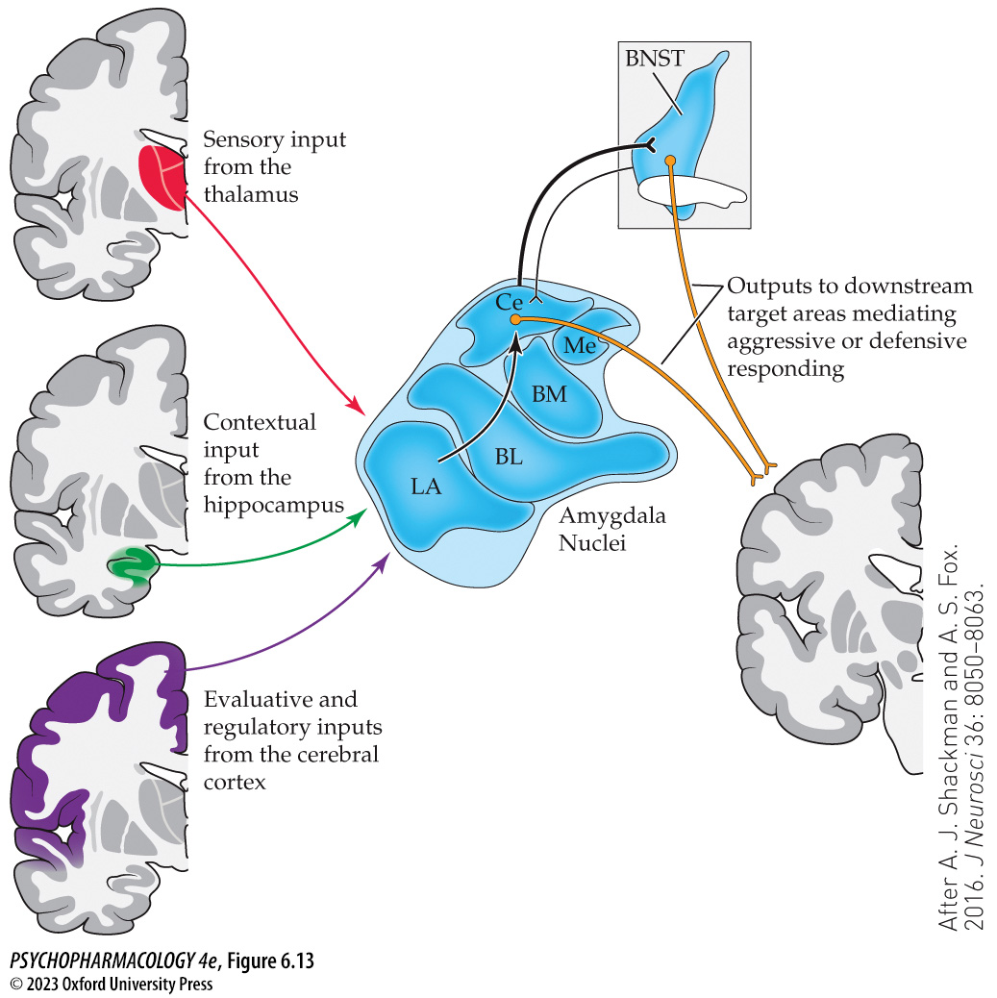
FIGURE 6.13 The amygdala–BNST circuit involved in threat processing
Notes:
FIGURE 6.13 The amygdala–BNST circuit involved in threat processing
The amygdala receives sensory input from the thalamus, contextual input from the hippocampus, and evaluative/regulatory inputs from the cerebral cortex. These inputs are received primarily by the lateral (LA) nucleus of the amygdala. Information processing within the amygdala involves connections from the lateral nucleus to the basolateral (BL) and basomedial (BM) nuclei, and from those areas to the central nucleus (Ce). The central nucleus provides input to the bed nucleus of the stria terminalis (BNST), and both the central nucleus and BNST project to downstream target areas that mediate either defensive or aggressive behavioral and physiological responses to the threat. Me, medial nucleus. (After A. J. Shackman and A. S. Fox. 2016. J Neurosci 36: 8050–8063.)

Slide 44
Behavioral and Physiological Functions of Serotonin (8 of 12)
Multiple approaches have identified several behavioral and physiological functions of serotonin
Serotonin deficiency hypothesis of aggression: low CNS serotonergic activity is associated with hyperaggressiveness; supported by animal studies
The SSRI sertraline can reduce anger and irritability in a variety of psychiatric disorders
Relationship between 5-HT and aggression in humans may be more complex
Notes:
Instructor Notes:

Slide 45
Behavioral and Physiological Functions of Serotonin (9 of 12)
Multiple approaches have identified several behavioral and physiological functions of serotonin
Serotonin influences hunger and eating behavior
Neurons in AN secrete α-melanocyte stimulating hormone (α-MSH), and neuropeptide Y (NPY) and agouti-related peptide (AgRP).
Both neurons project to the PVN and synapse on melanocortin receptor neurons; α-MSH is an agonist at the MC_{3/4} receptors; AgRP block the effect
Activation of MC_{3/4} receptors is anorexigenic (appetite-suppressing), inhibition of these receptors by AgRP is orexigenic (appetite-promoting)
The selective 5-HT_{2C} agonist lorcaserin (Belviq) was developed for the treatment of obesity
Notes:
Instructor Notes:
AN = arcuate nucleus, PVN = paraventricular nucleus
POMC: pro-opiomelanocortin (POMC), a large peptide that is broken down into the smaller bioactive molecule α-MSH.

Slide 46
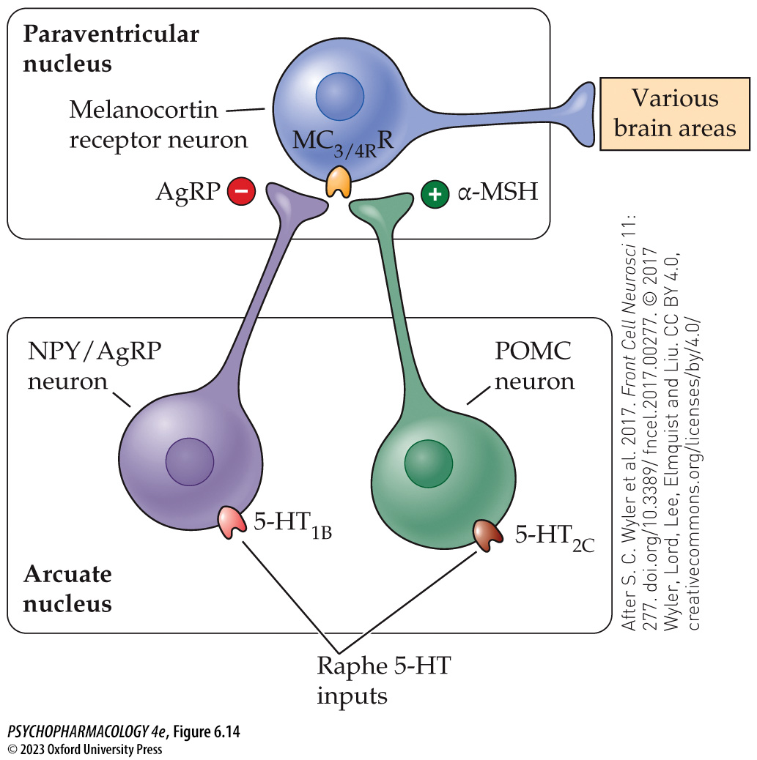
FIGURE 6.14 Neural circuit through which 5-HT suppresses appetite
Notes:
FIGURE 6.14 Neural circuit through which 5-HT suppresses appetite
Appetite (motivation to eat) is controlled by a circuit of neurons within the arcuate and paraventricular nuclei of the hypothalamus. Arcuate neurons that co-express NPY and AgRP send orexigenic signals to melanocortin receptor neurons in the paraventricular nucleus, while POMC neurons send a contrasting anorexigenic signal instead. The anorexigenic signal is mediated by α-MSH activation of MC_{3/4} receptors, whereas the orexigenic signal is mediated by a combination of AgRP blocking of the MC_{3/4} receptors and NPY activation of its own receptors on the melanocortin neurons (not shown). 5-HT released from DRN and MRN projections to the arcuate nucleus exerts an anorexigenic effect by dual mechanisms: stimulation of the POMC neurons through excitatory 5-HT_{2C} receptors and suppression of the NPY/AgRP neurons through inhibitory 5-HT_{1B} receptors. The balance of orexigenic and anorexigenic signals is integrated by the melanocortin receptor neurons to determine the organism’s appetitive state, which is then transmitted to other brain areas responsible for food seeking and eating behaviors as well as the physiological systems that are coordinated with food intake. Note that the figure omits many other neurotransmitters and bloodborne hormones that influence this circuit. AgRP, agouti-related peptide; α-MSH, α-melanocyte stimulating hormone; MC_{3/4}R, melanocortin 3 and melanocortin 4 receptors; NPY, neuropeptide Y; POMC, pro-opiomelanocortin. (After S. C. Wyler et al. 2017. Front Cell Neurosci 11: 277. doi.org/10.3389/fncel.2017.00277. © 2017 Wyler, Lord, Lee, Elmquist and Liu. CC BY 4.0, creativecommons.org/licenses/by/4.0/)

Slide 47
Behavioral and Physiological Functions of Serotonin (10 of 12)
Multiple approaches have identified several behavioral and physiological functions of serotonin
Most of the body’s 5-HT is located in the gut, in the enteric nervous system, and synthesized by enterochromaffin cells using TPH1.
Food in the gut stimulates 5-HT release – promotes secretion of metabolic hormones and increases peristaltic activity.
Notes:
Instructor Notes:

Slide 48
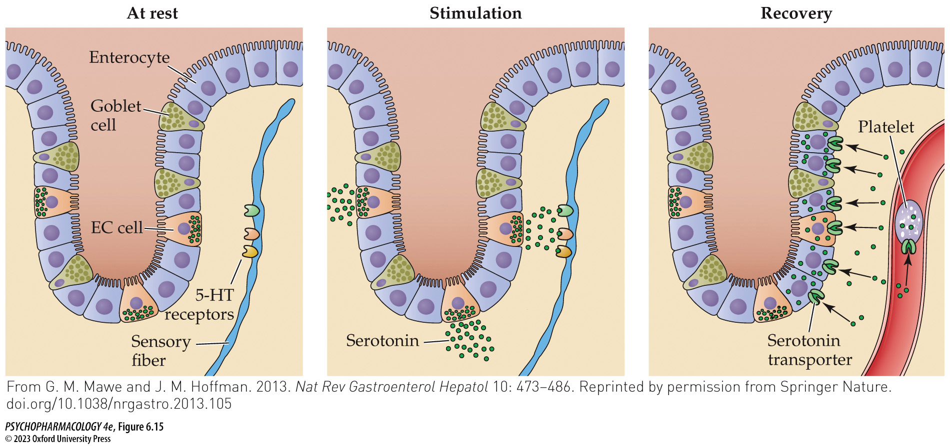
FIGURE 6.15 Release and uptake of 5-HT in the intestine
Notes:
FIGURE 6.15 Release and uptake of 5-HT in the intestine
Serotonin is synthesized by specialized secretory cells in the intestinal wall called enterochromaffin (EC) cells. The other cell types depicted in the figure are enterocytes, which are epithelial cells that mediate absorption of nutrients from the gut, and goblet cells, which secrete a layer of protective mucus that lines the intestinal wall. From left to right, the figure first depicts a resting state characterized by minimal 5-HT release, a stimulated state during which 5-HT released by EC cells activates serotonergic receptors on intestinal sensory fibers, and a recovery state in which the released 5-HT is cleared by uptake either into cells of the intestinal wall or into blood platelets in the case of 5-HT molecules that have diffused into the bloodstream. Such uptake is mediated by the serotonin transporter, which is expressed by the EC cells, enterocytes, and platelets. (From G. M. Mawe and J. M. Hoffman. 2013. Nat Rev Gastroenterol Hepatol 10: 473–486. Reprinted by permission from Springer Nature. doi.org/10.1038/nrgastro.2013.105)

Slide 49
Behavioral and Physiological Functions of Serotonin (11 of 12)
Multiple approaches have identified several behavioral and physiological functions of serotonin
The 5-HT₃ antagonist alosetron (Lotronex) is approved for treating irritable bowel syndrome (IBS), but has potentially dangerous side effects; a partial agonist my prove effective
Two 5-HT₄ agonists are currently licensed for treating IBS-C: prucalopride (Motegrity) and tegaserod (Zelnorm)
Notes:
Instructor Notes:

Slide 50
Behavioral and Physiological Functions of Serotonin (12 of 12)
CLICKER QUESTION 3
What is the most consistently observed behavioral effect in TPH2 knockout mice?
Aphagia
Maternal deficit
Abnormal sleep cycles
Increase in aggressive behavior
Notes:
Instructor Notes:
Correct answer: d

Slide 51
Review of Learning Objectives (3 of 3)
6.3.1 (a) Identify the various methodological approaches used to study serotonergic functioning in humans and in laboratory animals, and (b) describe the behavioral and physiological consequences of genetically manipulating animals so that they lack brain 5-HT throughout life.
6.3.2 Describe the role of 5-HT in anxiety, with an emphasis on the 5-HT1A receptor subtype.
6.3.3 Describe (a) the differences between reactive and proactive aggression in humans, (b) the neural circuitry that mediates reactive aggression, and (c) the serotonin deficiency hypothesis of aggression.
6.3.4 Explain how 5-HT is involved in the control of hunger and eating behavior, including both central (i.e., hypothalamic) and peripheral (i.e., gut) mechanisms.

